Slide 1

A Blended Multi-Model Ensemble for Predicting Cases of Infectious Diseases
Student: Xu De Ren
SUPERVISOR: Ts. Dr. Chan Weng Howe
Prof. Dr. Habibollah Haron (retired)
Panel & Examiner(s): AP Dr. Shahreen Kasim (UTHM)
Prof. Dr. Azlan Mohd Zain
Prof. Ts. Dr. Dayang Norhayati Abang Jawawi (Chairman)
Dr. Noor Hidayah Zakaria (Assistant Chairman)
Faculty of Computing
27th October 2024

Slide 2

Presentation Outlines
Introduction
Problem Statement
Research Objectives
Research Scope and Significance
Literature Review
Methodology
Results and Discussion
Conclusion
Future Work
Acknowledgments
Q&A
Page 2

Slide 3
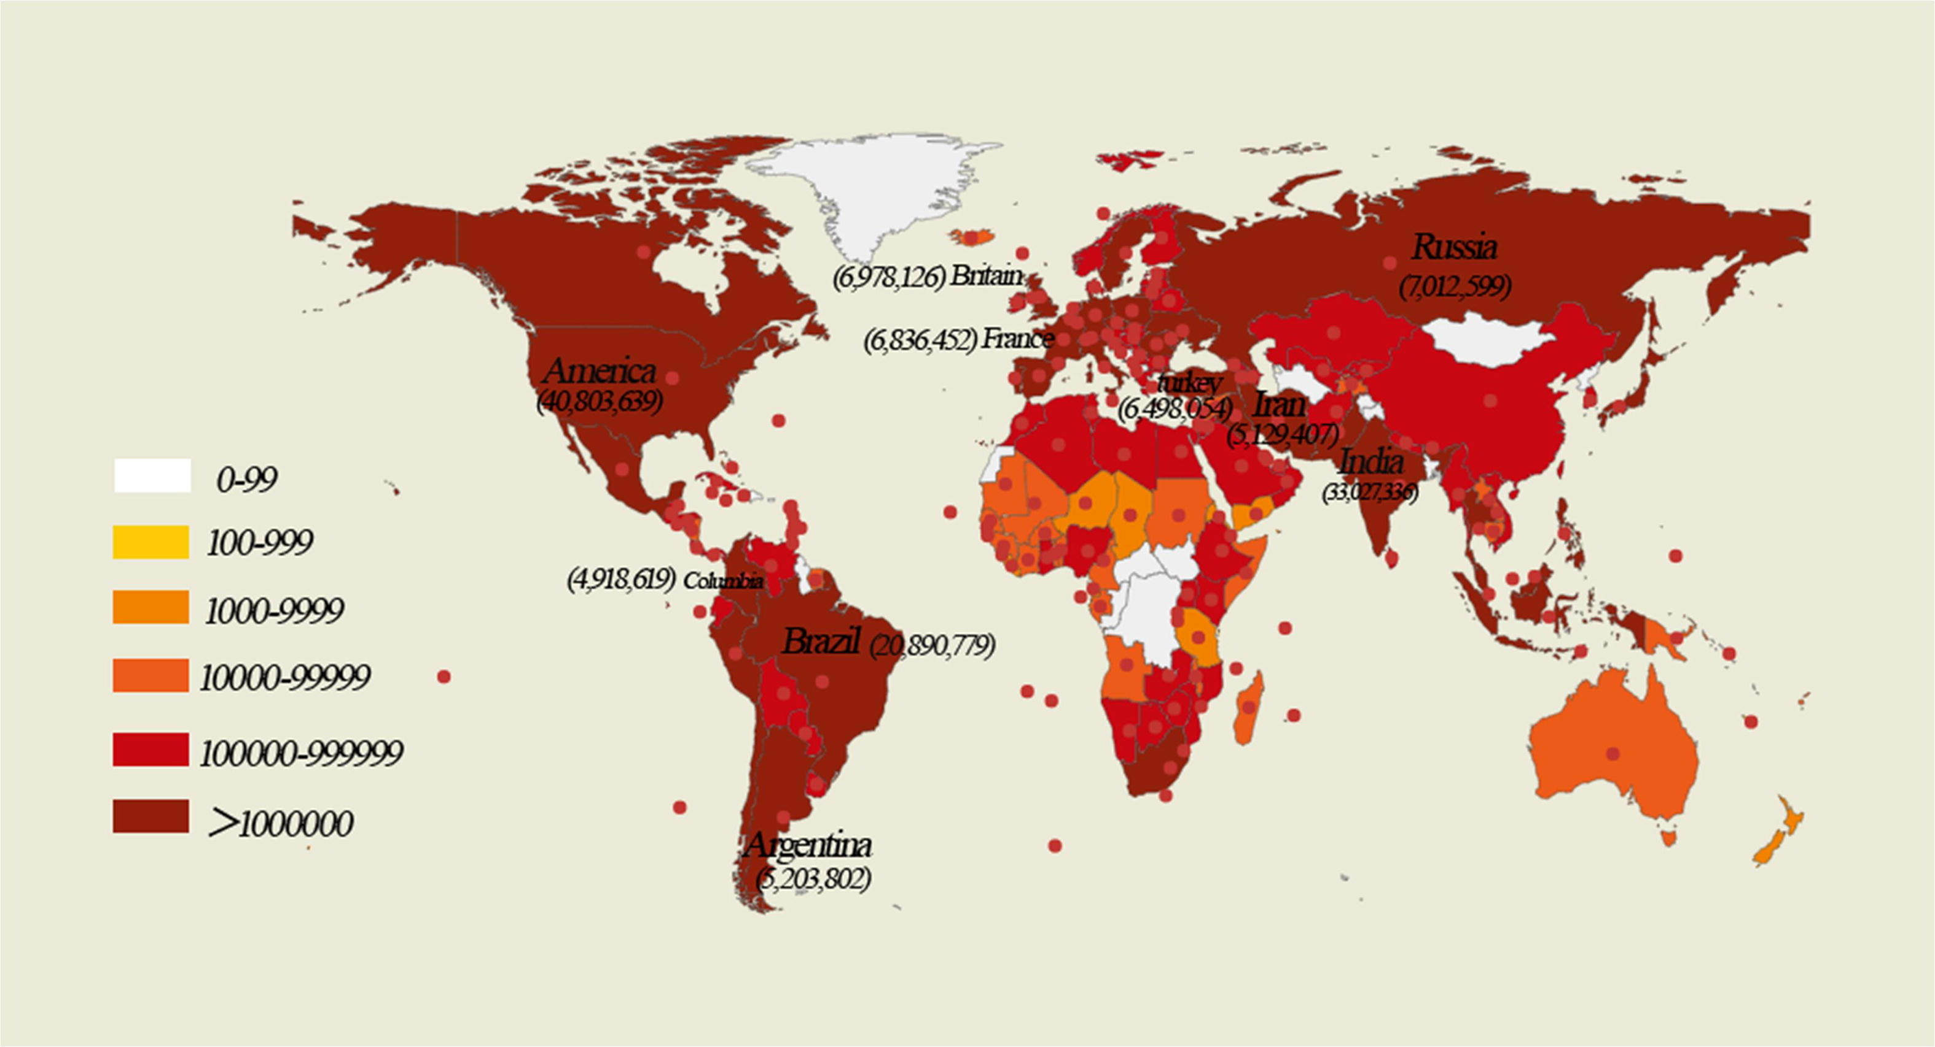
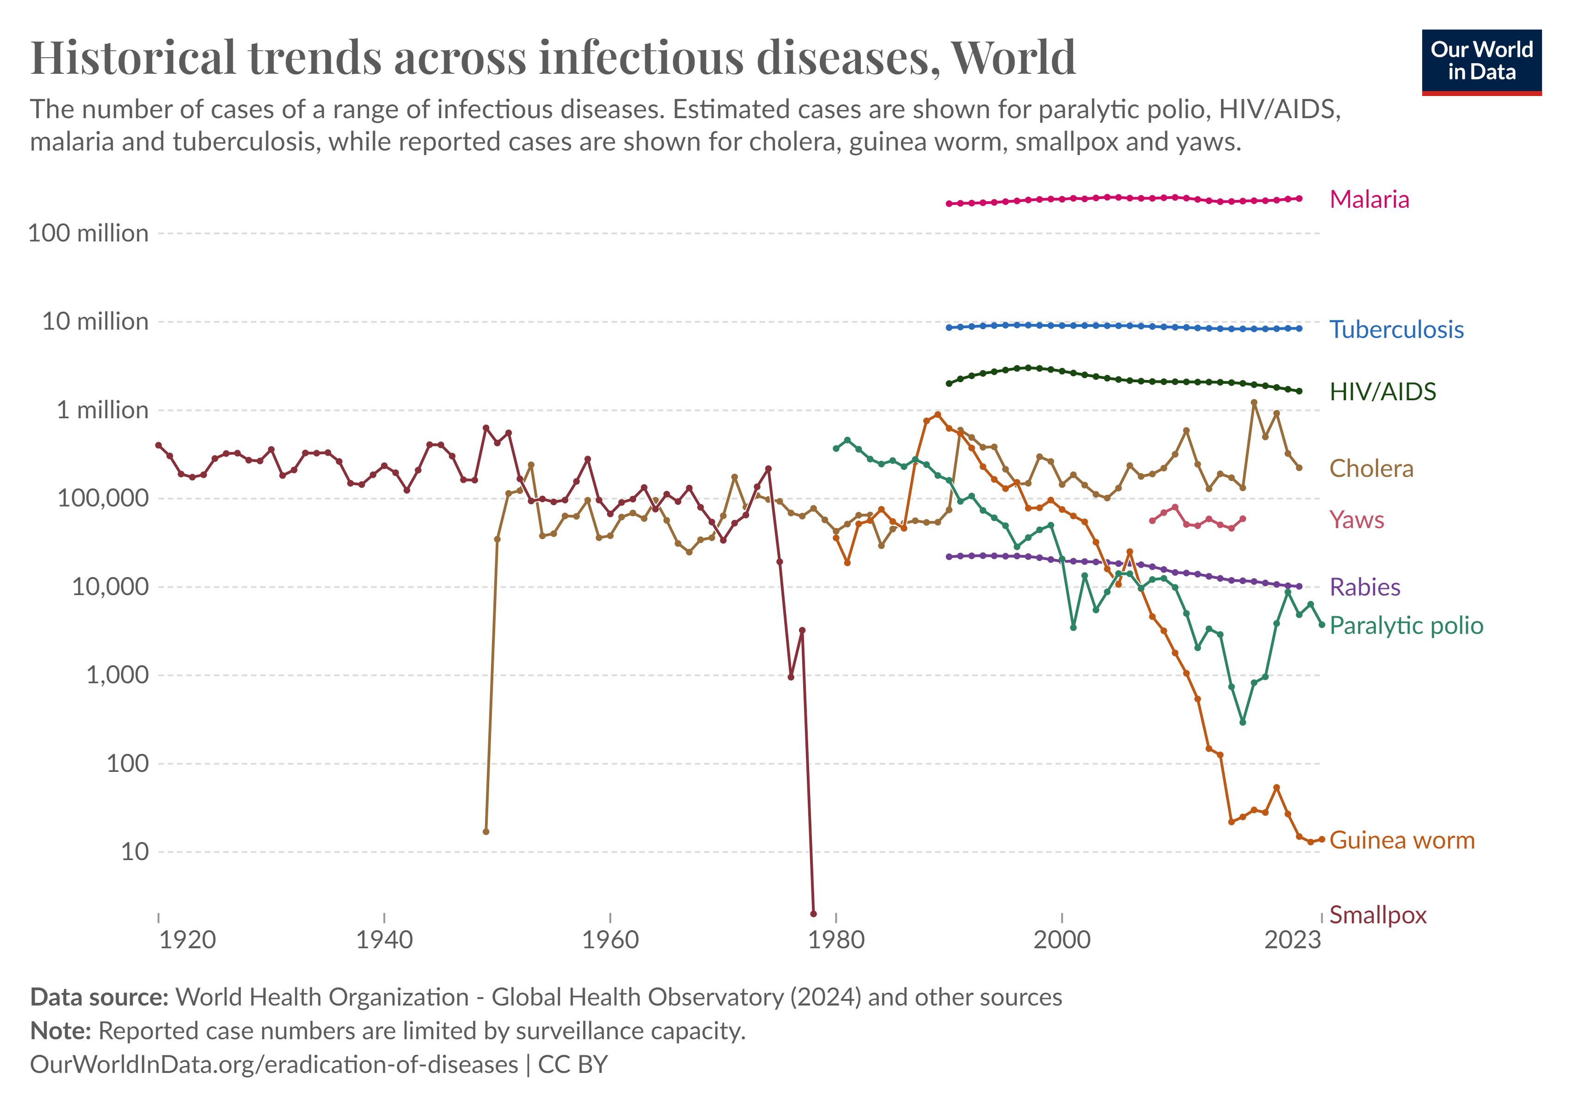
Chapter 1：Background
Infectious diseases like COVID-19 and Monkeypox have significant societal impacts.
Early prediction and prevention are critical for control.
AI advancements offer new opportunities for disease prediction.
Global Map of COVID-19 Cases 2019
World Historical Hrends Across Infectious Diseases.
Page 3

Slide 4
Problem Background
Single-model approach
mathematical models
time series models
machine learning and deep learning models
Ensemble learning
Limitations remain in generalizing and robustly discerning complex relationships over time
(Mugdha, Uddin et al. 2021)
Poor modeling forecast for nonlinear time series
(Wang, Pan et al. 2022).
The model requires a lot of training data and consumes a lot of training time
(Su, He et al. 2023).
Ensemble learning predictive models outperform individual models in improving predictive accuracy (Chatterjee and Byun 2023)
Limitations
Faster and better prediction of emerging infectious diseases when data are scarce
Focus of this research
Page 4

Slide 5
Problem Statement
Difficulty in model selection: Different forecasting models have different complexities and applicability.It is a challenge to select the most appropriate model for specific needs (Liu, Huang et al. 2023).
Lack of widely applied models: Due to the complexity of infectious disease transmission, different models have different applicability, and it is difficult to find a model that can be widely applied (Zarandian, Mohammadyari et al. 2023).
Establishing a long-term effective and high-accuracy tool for predicting emerging infectious diseases is an important problem to be solved urgently.
Early prediction of emerging infectious diseases is difficult.
Data scarce and time-consuming model reconstruction for emerging infectious diseases: The process of collecting the necessary training data and reconstructing the model is time-consuming and does not guarantee the predictive performance of the model (Hernández-López, Travieso-González et al. 2024).
Page 5

Slide 6
Research Aim/Objectives
Aim
This study aims to propose a blended model with ensemble of Ridge Regression, Decission Tree, and XGBOOST models to predict COVID-19 cases. The proposed blended model is then enhanced with transfer learning and incremental learning to enable effective adaptation to a new target task, which is monkeypox case prediction. The goal is to establish a sustainable blended ensemble model for predicting emerging infectious diseases.
Objective 1
Objective 2
Objective 3
To identify base models from deep learning and machine learning for prediction of COVID-19 cases using a multi-objective optimization approach.
To propose a blended multi-model ensemble from identified based models for more accurate COVID-19 cases prediction.
To enhanced the blended ensemble model with transfer learning and incremental learning for better adaptation to early prediction of emerging infectious diseases.
Page 6

Slide 7
Research Scope
Data collection
COVID-19 (2020–2023) and U.S. monkeypox (May 2022–Feb 2024) data were sourced from Our World in Data and cleaned for accuracy.
Model Selection
COVID-19 case prediction in Mexico using deep learning (FNN, TCN, CNN, LSTM) and machine learning (RF, Ridge, DT, XGBOOST) models.
Model Comparison
Models are compared and selected using multiobjective metrics: accuracy, generalization, and computational efficiency.
Create blending
The top-performing model, selected via multiobjective optimization, is used to build a blended ensemble model for improved COVID-19 case prediction in Mexico.
Response to emerging infectious diseases
The blending model, using transfer and incremental learning, adapts to predict U.S. monkeypox cases in real-time, handling the evolving nature of infectious diseases.
Page 7

Slide 8
Chapter 2：Literature Review
legend
Focus on this research
Infectious disease prediction models
Models Classification
Mathematical Models
Statistical models
Machine Learning and Deep Learning
Hybrid Model
Ensemble Model
supervised learning
parallel hybrid
Boosting
SIR
ARIMA
Blending
unsupervised learning
Tandem hybrid
Bagging
SEIR
Stacking
semisupervised learning
Voting
reinforcement learning
Page 8

Slide 9
Limitations Of Existing Infectious Disease Prediction Techniques
Factors | Mathematical models | Statistical models | Machine learning and deep learning models | Hybrid models | Ensemble models
Objective | Capturing the spread of disease with a simple differential equation | Mathematical derivation of the closed nature of disease transmission | Provide generic models that can cover a wide range of scenarios | Take advantage of hybrid models to deliver better performance | Improve prediction accuracy by combining multiple predictive models to reduce variance and bias.
Limitation | The model is based purely on old, existing statistics and does not capture sudden changes in propagation and cannot handle more dynamic situations. | The assumed probability distribution may not be valid for all cases. | The model requires a large amount of training data, which consumes a lot of training time | It is very complex as the model consists of a mixture of many models. | The complexity of the ensemble can lead to increased computational cost and model interpretability issues. It also requires careful tuning to avoid overfitting.
Page 9

Slide 10
Comparison of ensemble learning methods
Categories | Objectives | Integration methods | Application | literatures
Bagging | Variance | Voting method for classification problems, mean value method for regression problems | Model instability and high variance | (Reis, Souza et al. 2021, Wang, Zhao et al. 2023)
Boosting | Deviation | Weighted majority voting method | Enhanced Accuracy Captures Complex Patterns | (Tirados, Hope et al. 2020, Guldogan, Yagin et al. 2023, Wang, Wu et al. 2023)
Stacking | Deviations and room differences | Meta-Learner | Improve robustness and accuracy | (Zhou, Xin et al. 2023)(Vigier, Vigier et al. 2021)
voting | Reduction of misclassification risk | Majority voting for classification (hard voting), average probability voting for regression (soft voting) | For diverse models and complex datasets | (Risseeuw, van Leeuwen et al. 2020, Jamshidi Gohari, Emami Niri et al. 2023)
blending | Reduction of overfitting and error variance | Use outputs of first-level models as inputs to a second-level model to make final predictions | Suitable for diverse models and time-critical scenarios | (Ortmann, Rychetsky et al. 1999, Rocks and Mehta 2022)
Page 10

Slide 11

Literature Review - Research Gaps and opportunities
The prediction performance of a single model is limited, ensemble learning has been widely applied to the prediction of infectious diseases.
Transfer learning improves model performance when data is scarce.
Incremental learning allows models to be updated in real time as new data is added.
These techniques provide new perspectives for early prediction of emerging infectious diseases
Page 11

Slide 12
This Study
Blending
+
Transfer Learning
+
Incremental learning
This study propose blending techniques by combining Ridge, DT, and XGBOOST models to predict the number of COVID-19 cases. We subsequently apply transfer learning and incremental learning techniques to adapt the well-performing blending model from the source task (COVID-19 case prediction) to a new target task (monkey pox case prediction). The goal is to establish a sustainable framework for predicting emerging infectious diseases.
Page 12

Slide 13
Chapter 3： Research Framework
Phase I Model Selection Using Multi-Objective Optimization
Objective 1
To identify base models from deep learning and machine learning for prediction of COVID-19 cases using a multi-objective optimization approach
Data processing
COVID-19 data cleaning Segmentation
Model Prediction
Model selection Model training Parameter tuning
Model Assessment
Model prediction evaluation indicators
Output
Model prediction results Model evaluation results
Phase 2 Design And Develop The Blended Ensemble Model
Objective 2
To propose a blended multi-model ensemble from identified based models for more accurate COVID-19 cases prediction
Designing the blending integration framework
Proposed blending to predict COVID-19
Model Assessment
Model prediction evaluation indicators
Output
Model prediction results Model evaluation results
Phase 3 Enhanced Blended Ensemble Model with Transfer Learning and Incremental Learning
Objective 3
To enhanced the blended ensemble model with transfer learning and incremental learning for better adaptation to early prediction of emerging infectious diseases
Data processing Monkeypox data cleaning Segmentation
Enhanced blending to predict monkey pox
Model Assessment
Model prediction evaluation indicators
Output
Model prediction results Model evaluation results
Page 13

Slide 14
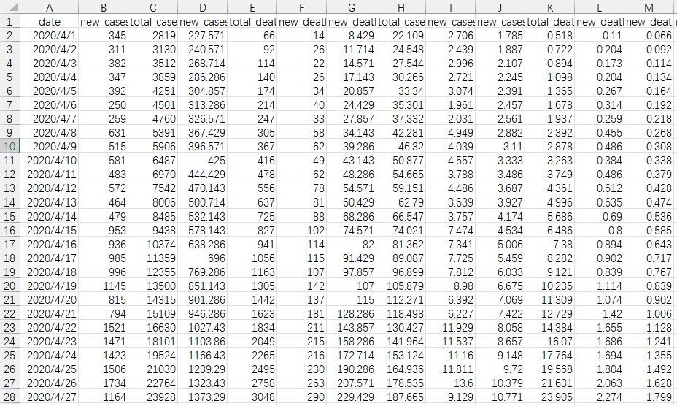
Dataset and Data Preprocessing
Data processing
Dataset | Data cleaning | Access URL | Dataset | Data cleaning | Access URL
COVID-19 | Median fills in missing values and retains outliers | https://ourworldindata.o rg/explorers/covid? | Monkey pox | Median fills in missing values and retains outliers | https://ourworldindata.o rg/explorers/Monkey pox?
Target Variables
Features
Data | Country | time scale
COVID-19 | Mexican | 2020/4/1 - 2023/3/30
COVID-19 | Iran | 2020/4/1 - 2022/12/31
COVID-19 | Indonesia | 2020/4/1 - 2023/1/2
COVID-19 | Chile | 2020/3/23 - 2023/3/31
Monkey pox | US | 2022/5/29 - 2024/2/27
Page 14
Data used in this study
A portion of the dataset

Slide 15
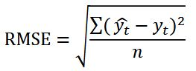
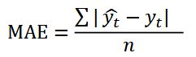
Methodology - Evaluation Metrics
Evaluation Metrics | Measurement methods
Prediction accuracy RMSE
Prediction accuracy MAE
Computational efficiency | The total time from the start of training to its completion is measured. This includes the training times for the base models as well as the meta-model. This can be achieved using timing functions available in programming environments, such as the `time` module in Python.
Generalization | Similar to accuracy, Root Mean Squared Error (RMSE) is used as a metric to assess generalization. By calculating RMSE on an independent test set, the model’s adaptability to new data can be evaluated.
Page 15

Slide 16
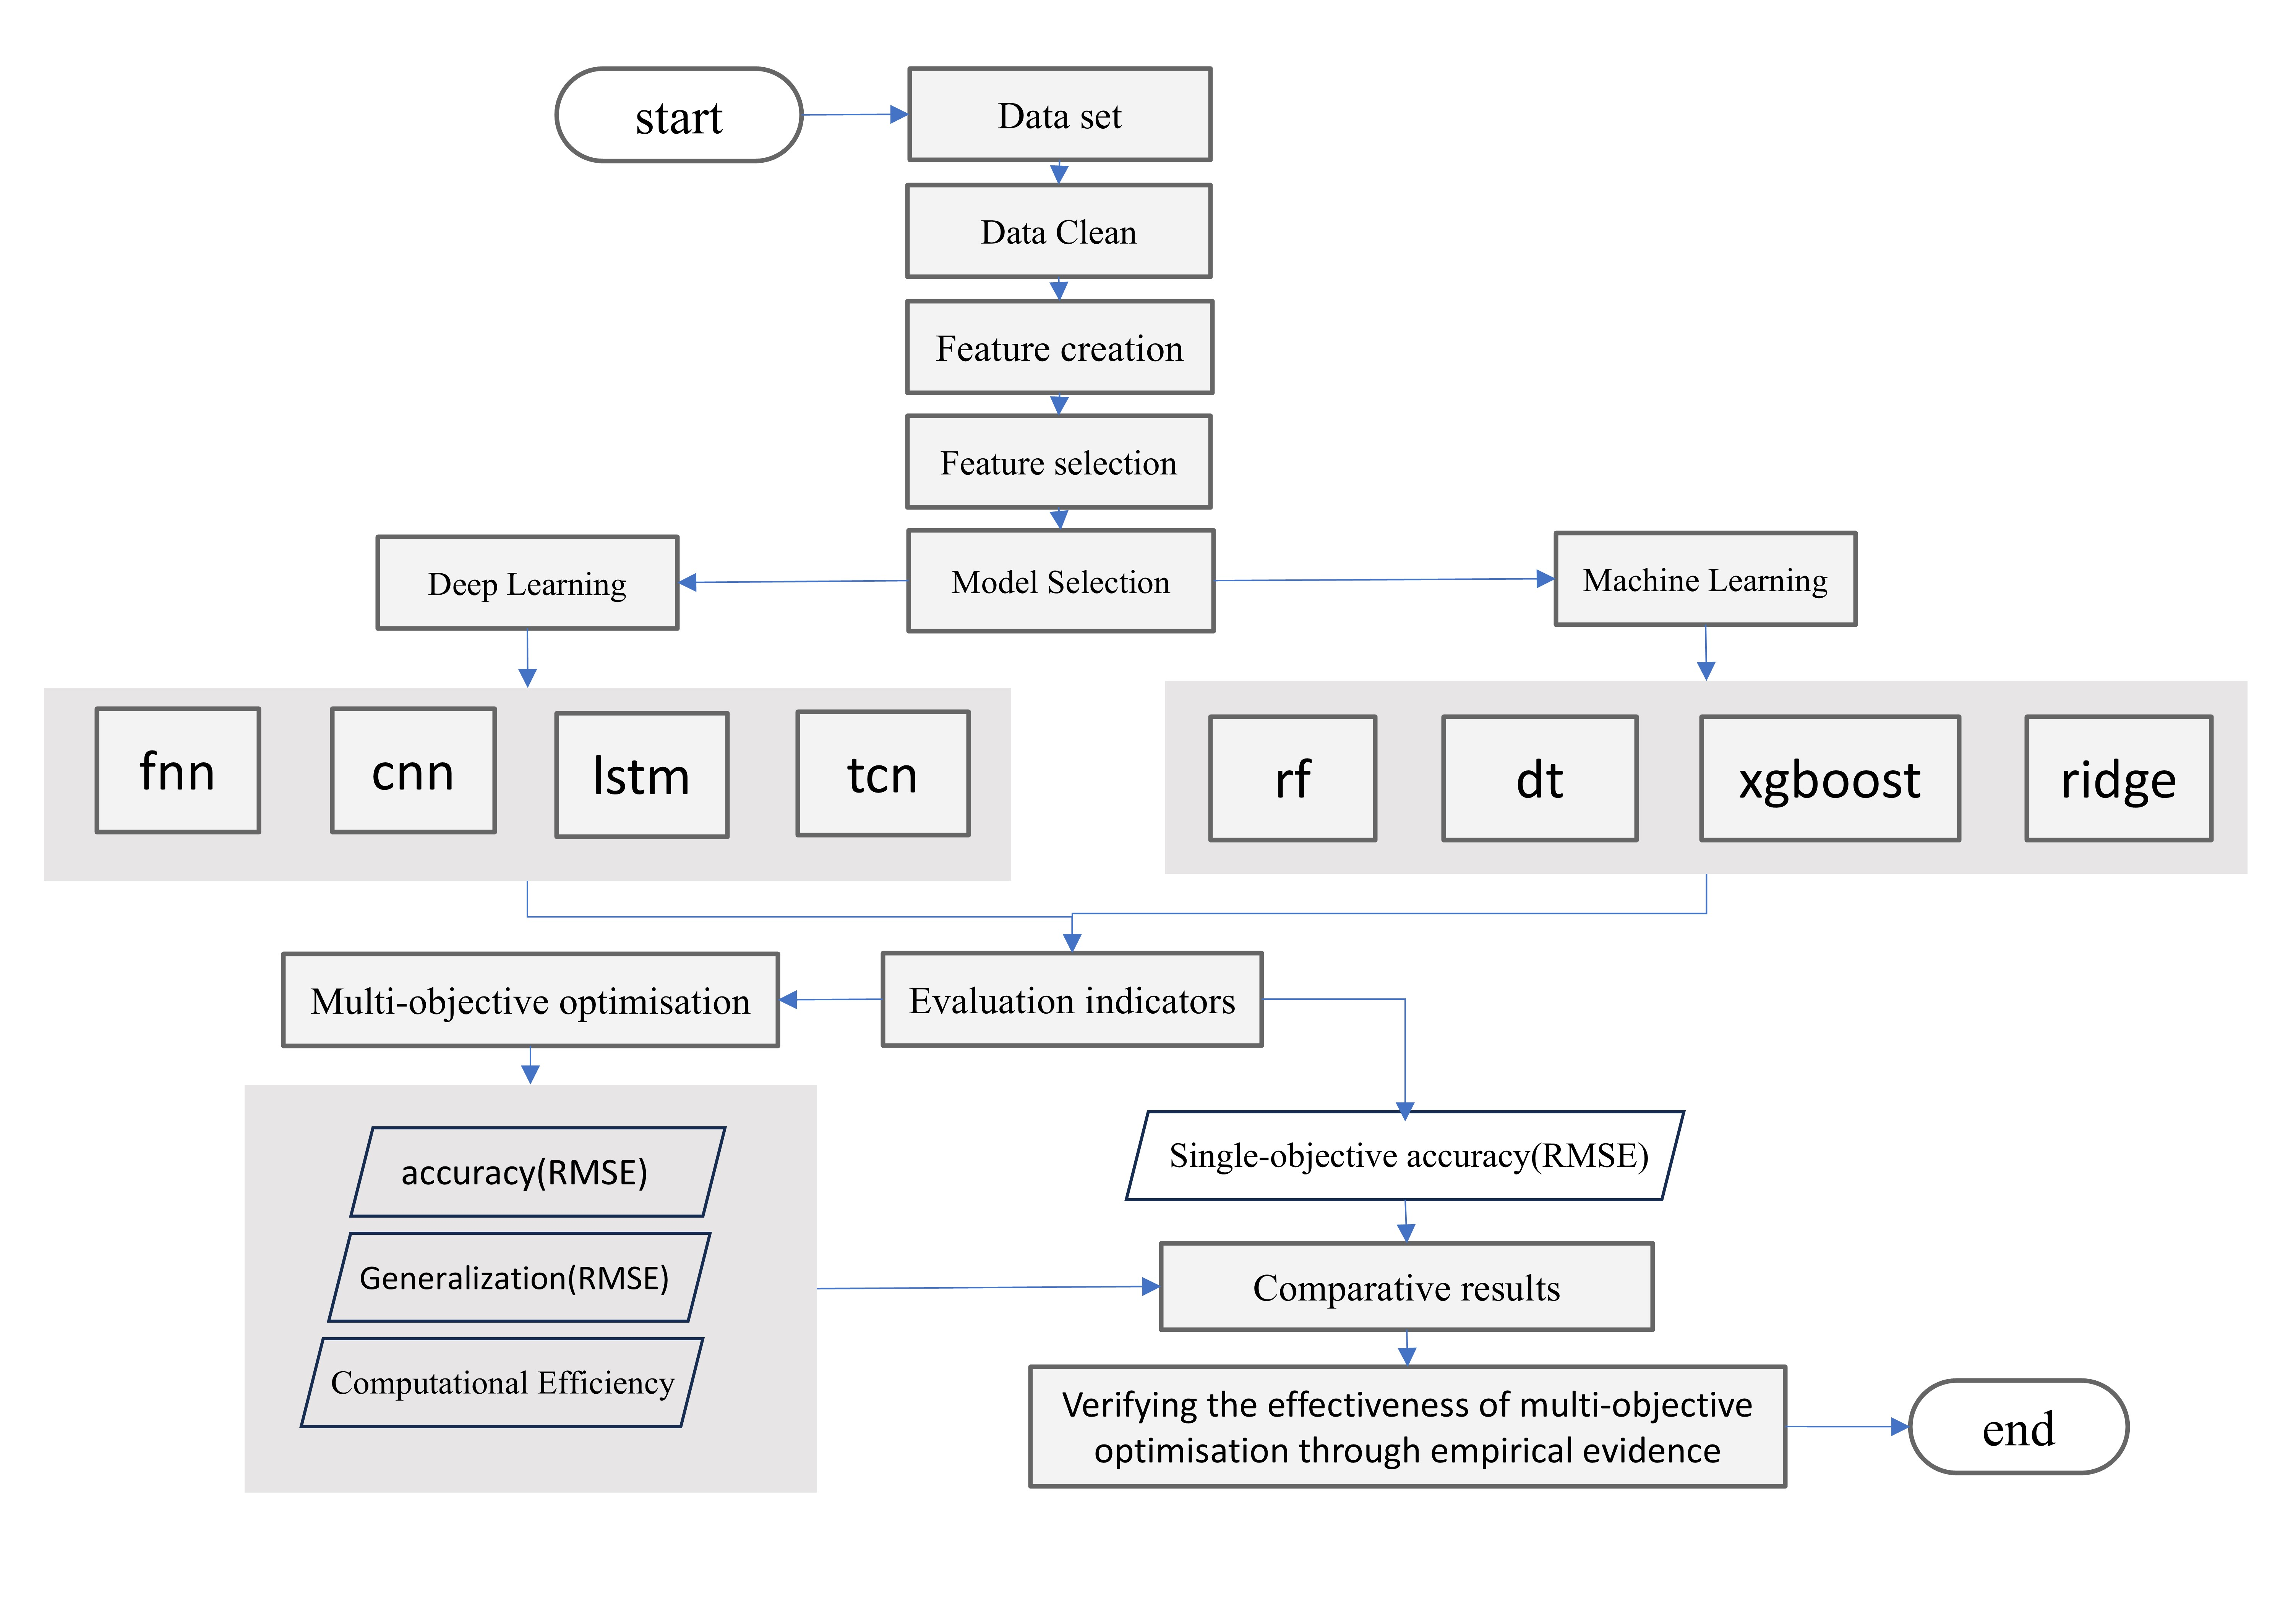
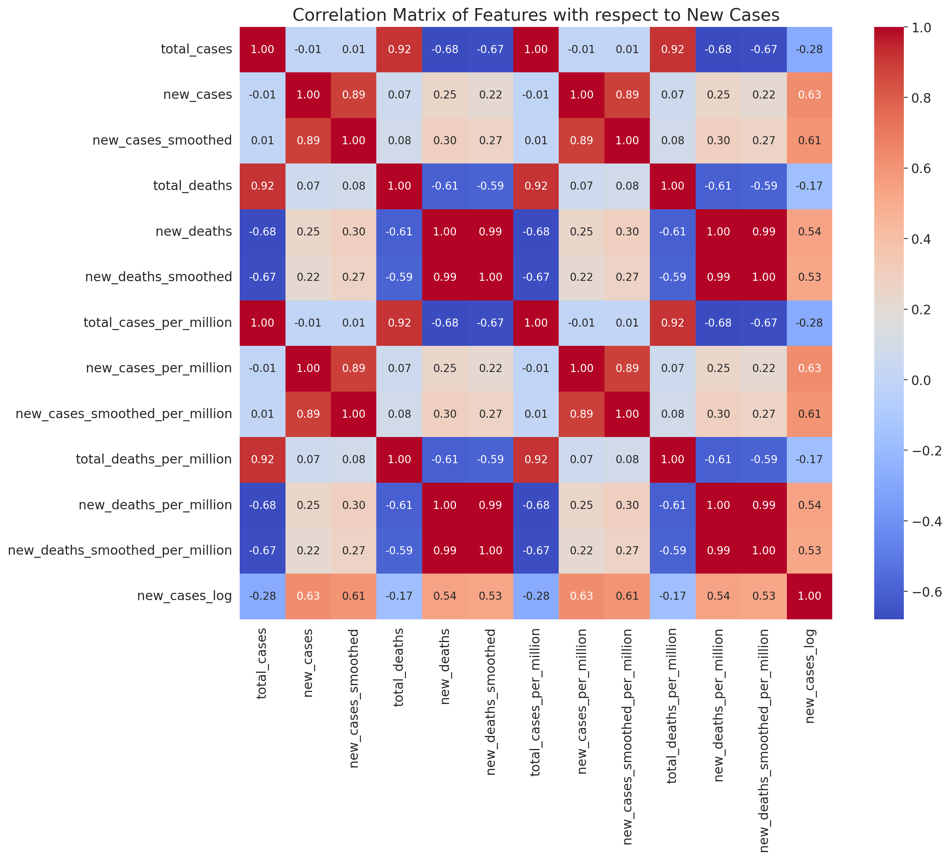
Chapter 4: Model Selection Using Multi-Objective Optimization
Used Features
total_cases, new_cases_smoothed, total_deaths, new_deaths, new_deaths_smoothed, total_cases_per_million, new_cases_per_million, new_cases_smoothed_per_million, total_deaths_per_million, new_deaths_per_million, new_deaths_smoothed_per_million, new_cases_log
Use Mexico COVID-19
Median fills in missing values and retains outliers
Create the new_cases_log feature.
Select features highly correlated with the target value.
Widely used in time series forecasting model Training and prediction.
Propose a multi-objective optimization method for model selection.
Validate the efficiency of the multi-objective optimization method.
Page 16
Xu, D., Chan, W. H., & Haron, H. (2024). Enhancing infectious disease prediction model selection with multi-objective optimization: an empirical study. PeerJ Computer Science, 10, e2217.

Slide 17
Model Prediction results
Name | Accuracy (RMSE) | Generalization Iran (RMSE) | Computational Efficiency
FNN | 152.025 | 4532.84 | 26.19 seconds
TCN | 231.014 | 2477.45 | 16.65 seconds
LSTM | 170.442 | 10307.7 | 35.16 seconds
CNN | 1144.36 | 5455.59 | 10.16 seconds
RF | 18.5805 | 1251.51 | 0.43 seconds
DT | 24.4889 | 8.1421 | 0.07 seconds
XGBOOST | 33.0709 | 13.0672 | 0.38 seconds
Ridge | 11.5274 | 114.852 | 0.03 seconds
Predicted results of model indicators
Page 17
Xu, D., Chan, W. H., & Haron, H. (2024). Enhancing infectious disease prediction model selection with multi-objective optimization: an empirical study. PeerJ Computer Science, 10, e2217.

Slide 18
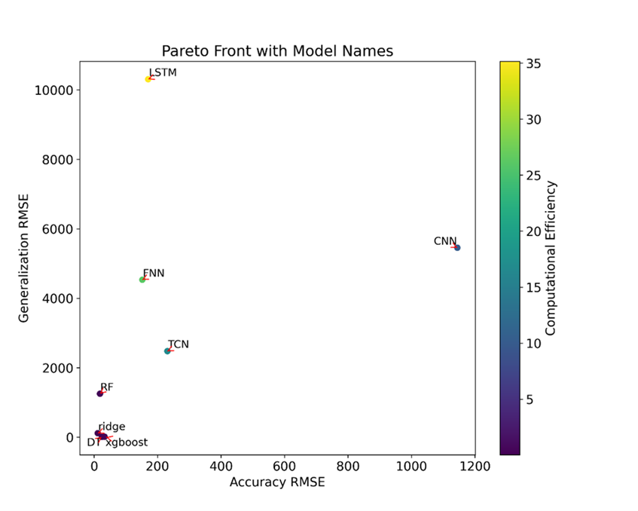
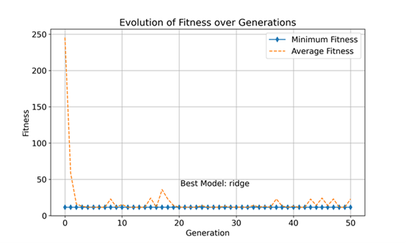
Comparison of Results from multi-objective vs single-objective
VS
Multi-objective Goal Optimisation for Accuracy (RMSE), Generalization (RMSE), Computational Efficiency.
Single-objective optimisation with Accuracy (RMSE) objective.
Page 18
Xu, D., Chan, W. H., & Haron, H. (2024). Enhancing infectious disease prediction model selection with multi-objective optimization: an empirical study. PeerJ Computer Science, 10, e2217.

Slide 19
Case Study Result
Model Name | Iran(RMSE) | Indonesia(RMSE)
DT | 8.1421 | 6.7367
XGBoost | 13.0672 | 13.5128
RIDGE | 114.8524 | 16.2552
Comparison of model performance in predicting RMSE for COVID-19 in Iran and Indonesia.
Single-objective optimisation vs. multi-objective optimisation:
Traditional studies usually focus on improving a single metric, such as prediction accuracy, ignoring other aspects.
This study provides a more comprehensive evaluation framework for model selection by considering multiple metrics simultaneously through multi-objective optimisation.
Page 19
Xu, D., Chan, W. H., & Haron, H. (2024). Enhancing infectious disease prediction model selection with multi-objective optimization: an empirical study. PeerJ Computer Science, 10, e2217.

Slide 20
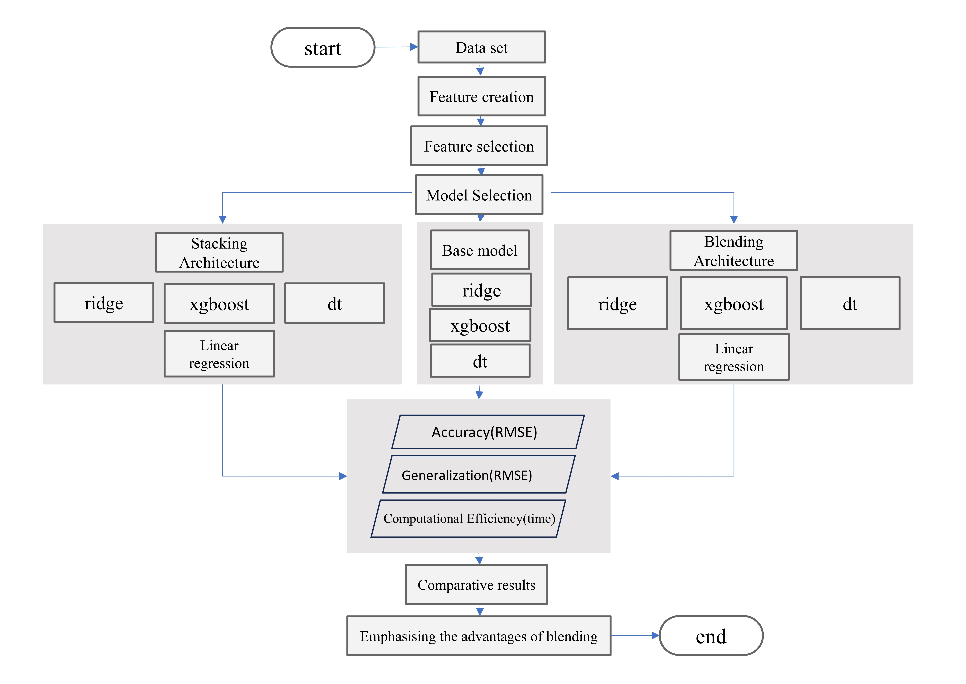
Chapter 5: Design And Develop Of The Blended Ensemble Model
new_cases_7d_avg
new_cases_14d_avg
new_cases_lag1
new_cases_lag7
new_cases_diff
new_cases_growth_rate
Year
Month
day_of_week
Ues Mexico COVID-19
Create features to capture disease transmission trends.
Models selected from Objective 1
Evaluating Feature Importance with xgboost
building blending and stacking.
Used features
new_cases_per_million new_deaths new_cases_lag1 day_of_week new_cases_diff new_cases_smoothed new_deaths_smoothed new_cases_14d_avg new_cases_lag7 total_cases month new_cases_growth_rate
Evaluate model performance.
Page 21

Slide 21
Experimental Results
Model Name | Accuracy (RMSE) | Generalization (RMSE,lran) | Generalization (RMSE,Indonesia) | Generalization (RMSE,Chile) | Model Training Time
Ridge | 11.52 | 114.85 | 16.25 | 23.24 | 0.03 seconds
XGBoost | 33.07 | 13.06 | 13.51 | 7.98 | 0.36 seconds
Decision Tree | 24.48 | 8.14 | 6.73 | 4.44 | 0.07 seconds
Blending (proposed method) | 1.87 | 1.95 | 1.67 | 2.07 | 0.40 seconds
Blending outperforms the base models in all aspects of predictive performance.
Page 22

Slide 22
Experimental Results
Model Name | Accuracy (RMSE) | Generalization (RMSE,lran) | Generalization (RMSE,Indonesia) | Generalization (RMSE,Chile) | Model Training Time
Stacking | 73.81 | 66.51 | 72.34 | 126.39 | 1.17 seconds
Blending (proposed method) | 1.87 | 1.95 | 1.67 | 2.07 | 0.40 seconds
Blending and Stacking models differ significantly in implementation and performance
Page 24

Slide 23
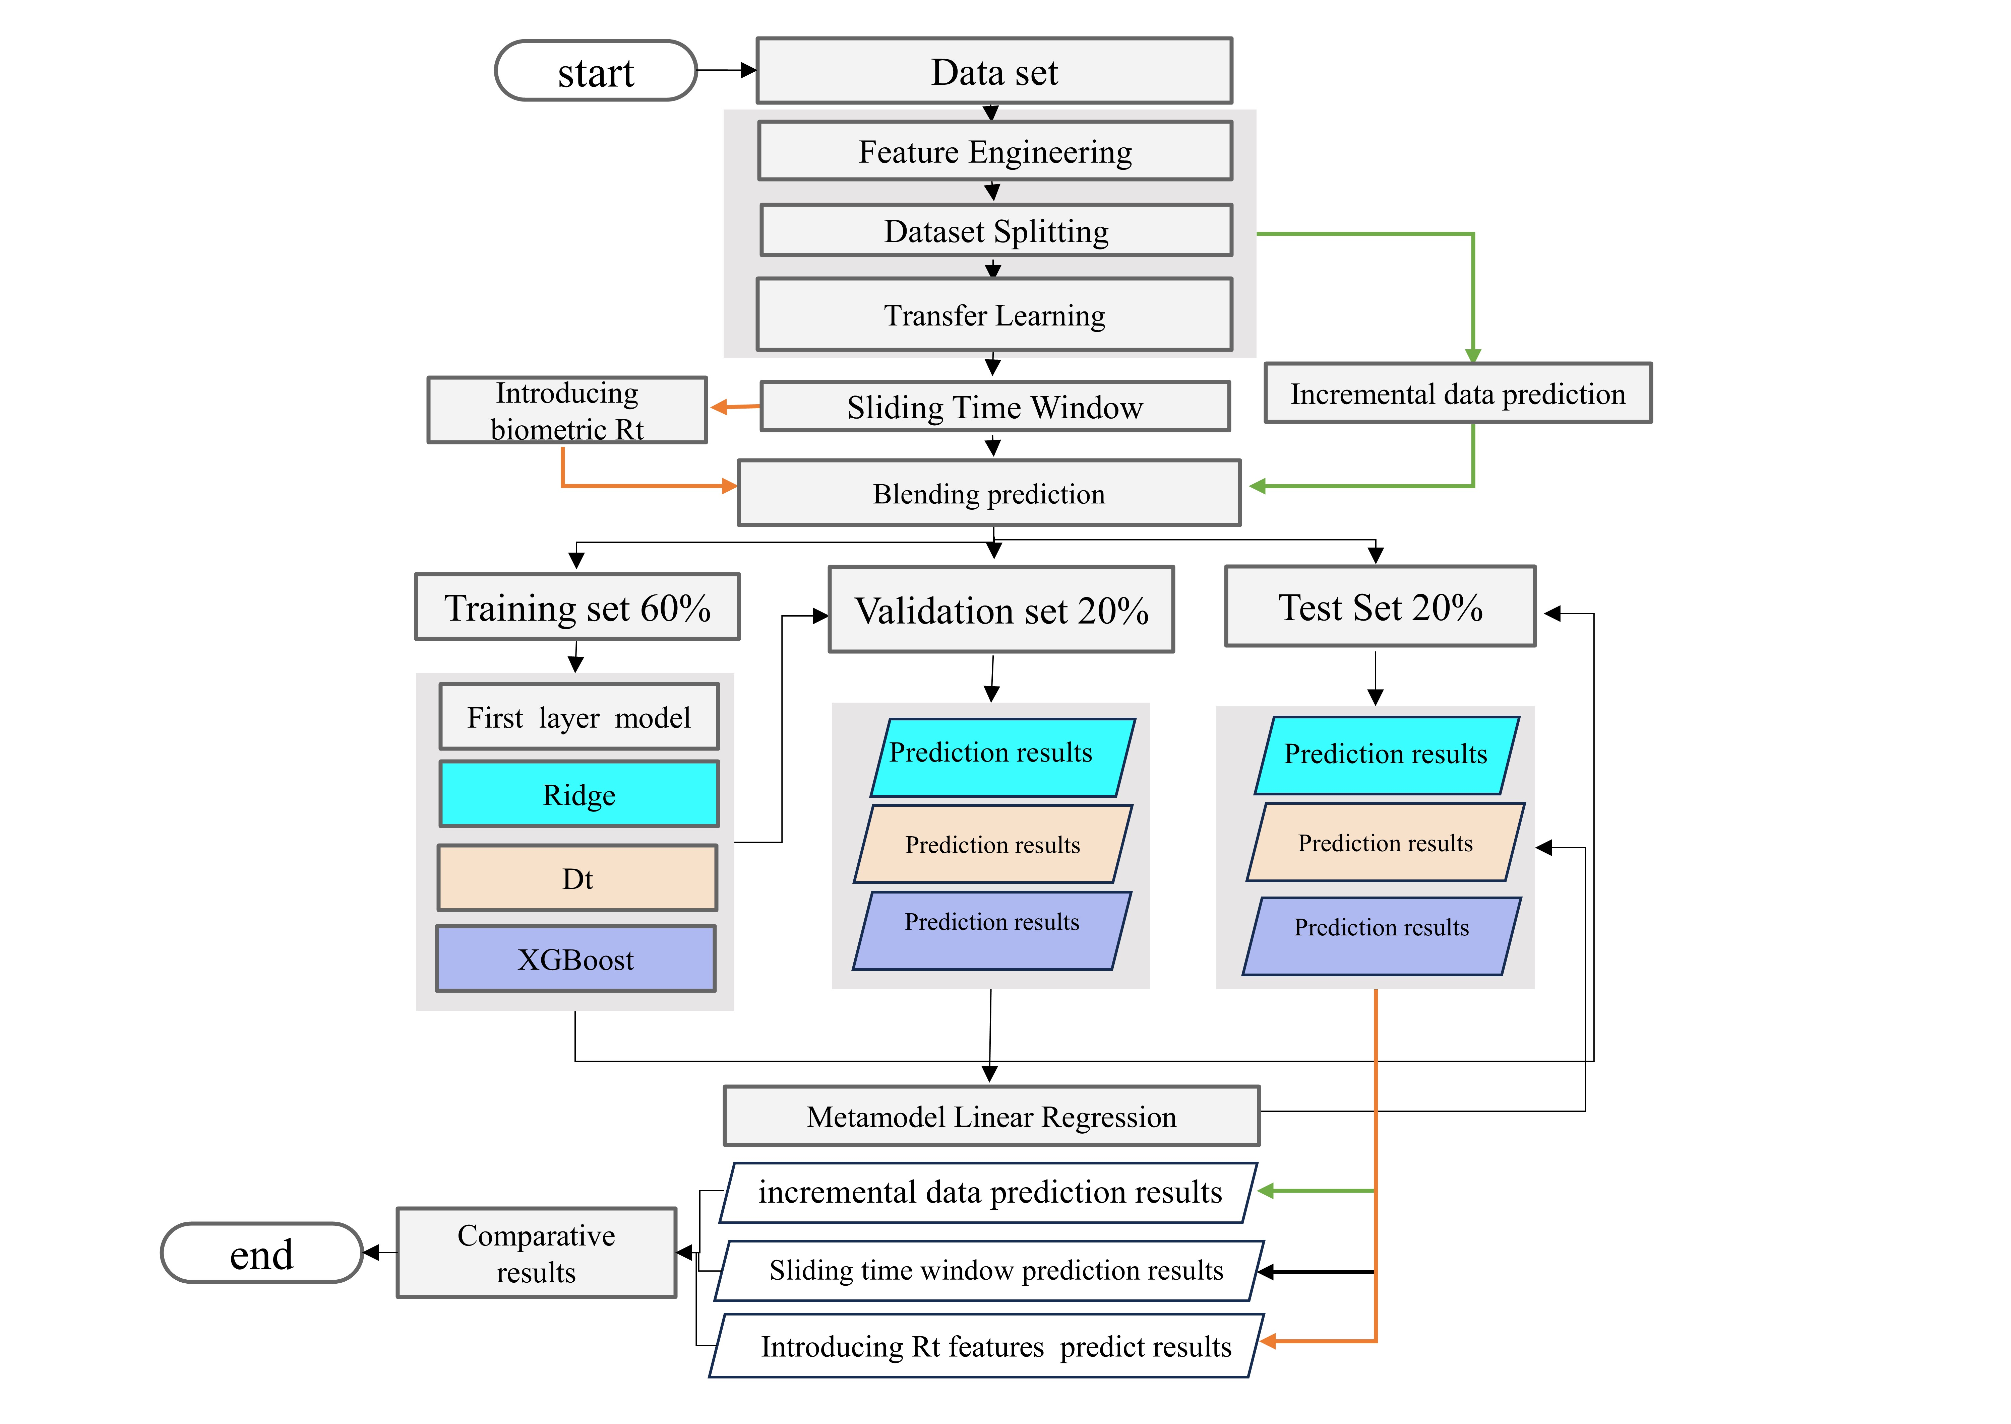
Chapter 6: Enhanced Blended Ensemble Model
new_cases_7d_avg
new_cases_14d_avg
new_cases_lag1
new_cases_lag7
new_cases_diff
new_cases_growth_rate
Year
Month
day_of_week
Ues Monkey pox and covid-19
Generate new features, then match and merge the two datasets.
The new dataset will be processed in three ways.
Import the previous COVID-19 blending model for training and prediction.
Used features
new_cases_per_million new_deaths new_cases_lag1 day_of_week new_cases_diff new_cases_smoothed new_deaths_smoothed new_cases_14d_avg new_cases_lag7 total_cases month new_cases_growth_rate Rt
Evaluate model performance.
Page 26
Xu, D., Chan, W. H., Haron, H., Nies, H. W., & Moorthy, K. (2024). From COVID-19 to monkeypox: a novel predictive model for emerging infectious diseases. BioData Mining, 17(1), 42. doi:10.1186/s13040-024-00396-8

Slide 24
Results - incremental data prediction
Times | Number of training set | Number of validation set | Number of test set | RMSE | MAE
30day | 18day | 6day | 6day | 5.94 | 4.19
37day | 23day | 7day | 7day | 10.06 | 9.22
44day | 26day | 9day | 9day | 18.64 | 15.88
51day | 31day | 10day | 10day | 57.18 | 49.25
Performance drop
Performance of blended ensemble models based on different on different incremental of time (in weeks).
Page 27
Xu, D., Chan, W. H., Haron, H., Nies, H. W., & Moorthy, K. (2024). From COVID-19 to monkeypox: a novel predictive model for emerging infectious diseases. BioData Mining, 17(1), 42. doi:10.1186/s13040-024-00396-8

Slide 25
Results - blending transfer learning, incremental learning, and Rt
Model Type | Times | RMSE | MAE
Transfer Learning Incremental Learning | Slide 0 weeks | 3.14 | 2.3
Transfer Learning Incremental Learning Rt | Slide 0 weeks | 3.14 | 2.3
Transfer Learning Incremental Learning | Slide 1 weeks | 2.49 | 1.94
Transfer Learning Incremental Learning Rt | Slide 1 weeks | 0.82 | 0.67
Transfer Learning Incremental Learning | Slide 2 weeks | 0.93 | 0.61
Transfer Learning Incremental Learning Rt | Slide 2 weeks | 0.45 | 0.31
Transfer Learning Incremental Learning | Slide 3 weeks | 0.27 | 0.25
Transfer Learning Incremental Learning Rt | Slide 3 weeks | 0.21 | 0.19
Page 28
Xu, D., Chan, W. H., Haron, H., Nies, H. W., & Moorthy, K. (2024). From COVID-19 to monkeypox: a novel predictive model for emerging infectious diseases. BioData Mining, 17(1), 42. doi:10.1186/s13040-024-00396-8

Slide 26
Chapter 7: Conclusion
The models selected by using multi-objective optimisation algorithm show significant advantages over traditional single-objective optimisation methods, and this study provides new theoretical support and practical methods for predictive model selection in public health decision support systems.
The blending model shows superior performance in terms of accuracy, generalisation and computational efficiency compared to single model and stacking methods. This studydemonstrates the potential application of blending in the field of infectious disease prediction.
This study combines blending, transfer learning, and incremental learning with biometric Rt techniques. An innovative prediction method is proposed. Multi-model blending and real-time data updating have great potential for application in infectious disease prediction. It provides theoretical support and technical guarantee for public health emergency response.
Page 30

Slide 27
Chapter 7: Research Contributions
We propose a multi-objective optimisation method for selecting the optimal prediction model in infectious disease prediction, and this new method outperforms the traditional single-objective method and enriches the theoretical basis of model selection in this field.
We demonstrate the effectiveness of blending in improving the performance and utility of COVID-19 prediction models. Our proposed blending achieves substantial improvements in prediction accuracy, generalisation and computational efficiency.
We developed a novel framework, and by transferring knowledge from the COVID-19 dataset to the monkeypox dataset and incorporating dynamic updating, our model effectively solves the data scarcity challenge, extends the applicability of traditional prediction models, and provides new theoretical and technical support for early warning of emerging infectious diseases.
Page 31

Slide 28
Chapter 7: Future Work
Although this study has made significant progress in the prediction of infectious diseases, there are still some limitations and directions for future research. The following areas warrant further research:
Exploring smarter optimization algorithms.
Efficiently integrating and dynamically updating real-time data.
Enhancing model clarity without compromising performance.
Page 32

Slide 29
Publications
No | Papers | Index
1 | Xu, D., Chan, W. H., & Haron, H. (2024). Enhancing infectious disease prediction model selection with multi-objective optimization: an empirical study. PeerJ Computer Science, 10, e2217. doi:10.7717/peerj-cs.2217 | SCI Q1. published
2 | A Multi-Objective Optimization Approach for COVID-19 Trend Prediction Using Blending Ensemble Learning. （Submited to Heliyon On 13-July-2024） | SCI Q1. Under review
3 | Xu, D., Chan, W. H., Haron, H., Nies, H. W., & Moorthy, K. (2024). From COVID-19 to monkeypox: a novel predictive model for emerging infectious diseases. BioData Mining, 17(1), 42. doi:10.1186/s13040-024-00396-8 | SCI Q1. published
4 | Xu, D., Yusuf, S. M., & Haron, H. (2022). Big data analytic tools in prediction of COVID-19 cases. In N. A. Ismail & M. Y. Abdullah (Eds.), Big data and machine learning with applications (pp. 175-188). Penerbit UTM Press. ISBN: 978-983-52-1857-6 | Chapter Books
Page 33

Slide 30

Acknowledgments
Special thanks to my supervisors, examiners and fellow students.
Thanks to my alma mater UTM for nurturing me.
Thanks to family and friends for their support.
Thank you for your attention.
Questions and discussions are welcome.
Page 34

